Slide 1


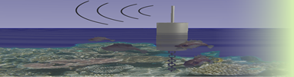




Digital Moorea Cyberinfrastructure for Coral Reef Monitoring
CREON Workshop March 2010 San Diego USA
Tony Fountain, Sameer Tilak, Peter Shin: UCSD
Sally Holbrook, Russell J. Schmitt, Andrew Brooks, Libe Washburn, David Salazar: UCSB

Slide 2

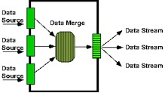
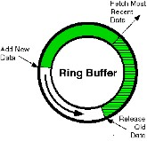
Open Source DataTurbine
Open Source Middleware for sensor networks and streaming data applications.
Provides support for integrating heterogeneous sensors and instruments.
Scalable support for in-network intelligent routing, data processing, filtering, and topology management
Originally developed by Creare Inc., http://www.creare.com/
OPEN SOURCE SOFTWARE - Apache 2.0. www.dataturbine.org

Slide 3
DataTurbine Application Models
Data Center Server – integrate and serve real-time data streams.
Networks of Sensors and Servers – move some processing functions into the network (e.g., buffering, topology management, reliable transport over intermittent networks).
Short-term experiments and campaign-style deployments (e.g., capture data streams for later replay and analysis).

Slide 4
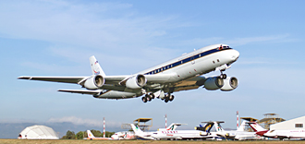
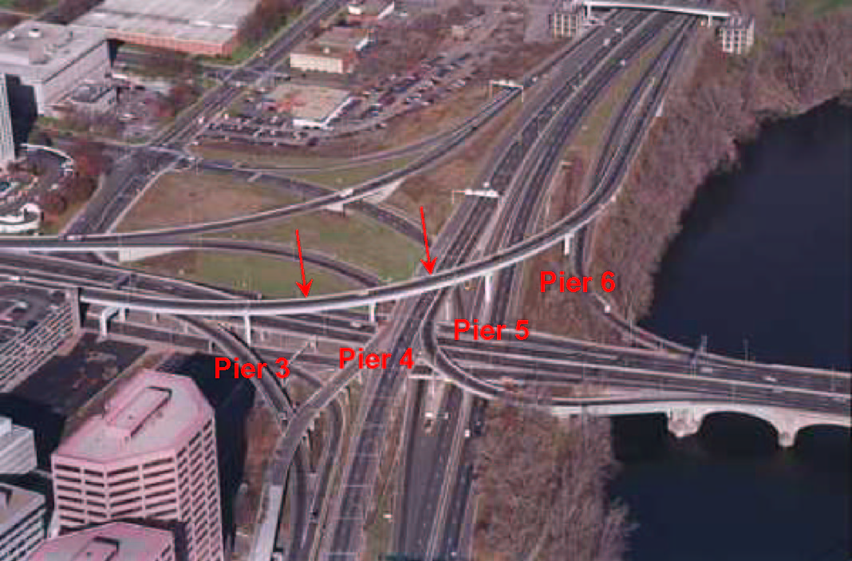
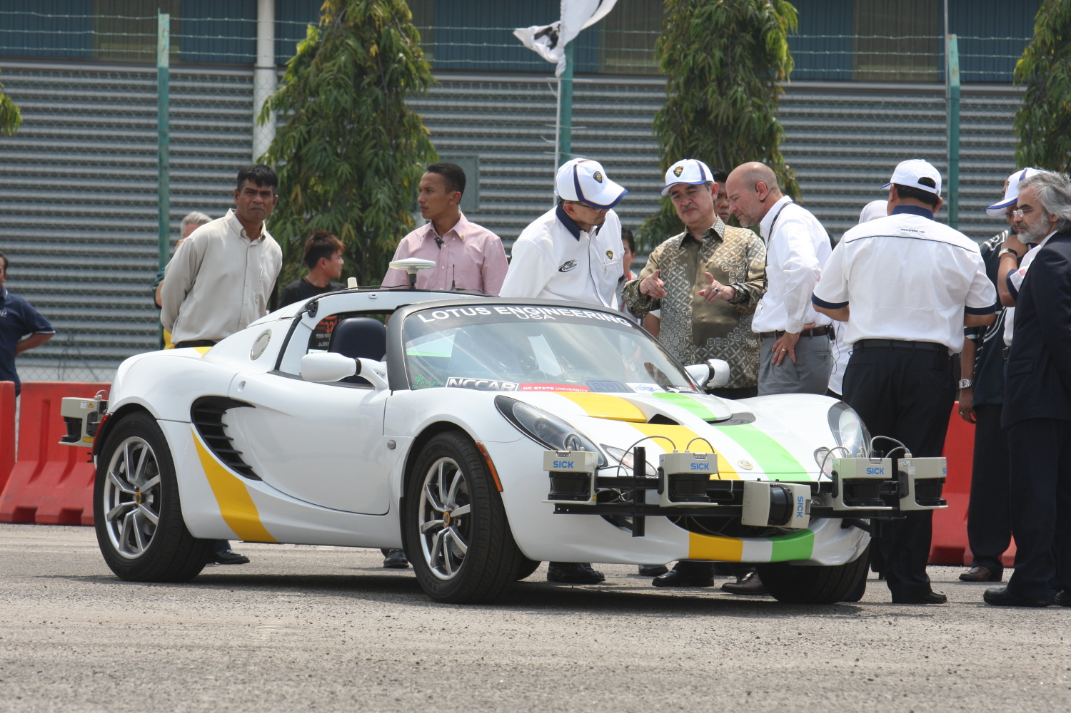
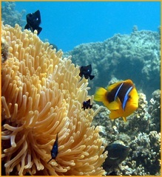
A Sampler of OSDT Applications
Structural Health Monitoring
Earthquake Engineering
Airborne Environmental Monitoring
Autonomous Vehicles
Coral Reef Monitoring
Lawrence C. Freudinger, NASA Dryden Flight Research Center
Rich Christenson, Univ. of Connecticut
Russell J. Schmitt, UCSB
Shep Pitts, Lotus Engineering and N Carolina State Univ.

Slide 5
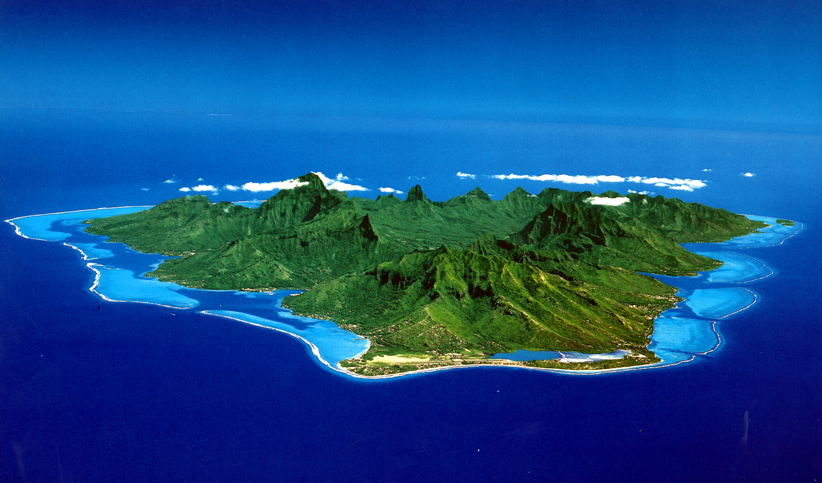
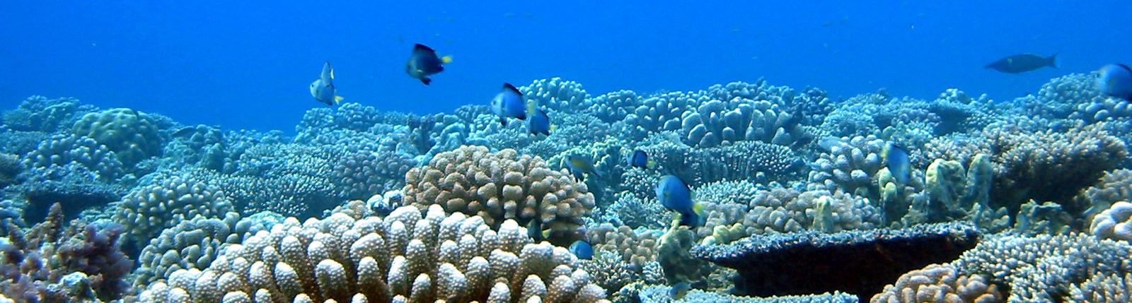
Digital Moorea
Coral Reef (MCR) LTER Site
How resistant are coral reefs to degradation?
After degradation, how rapid is recovery? (resilience)
Can rate of recovery keep up with rates of disturbance?
What is the joint effect of disturbances & climate forcing?
Integration of heterogeneous underwater sensors.
Real-time streaming of sensor data, wide area networks, wired and wireless.
Integrated cyberinfrastructure for acquisition, event detection, and modeling.

Slide 6
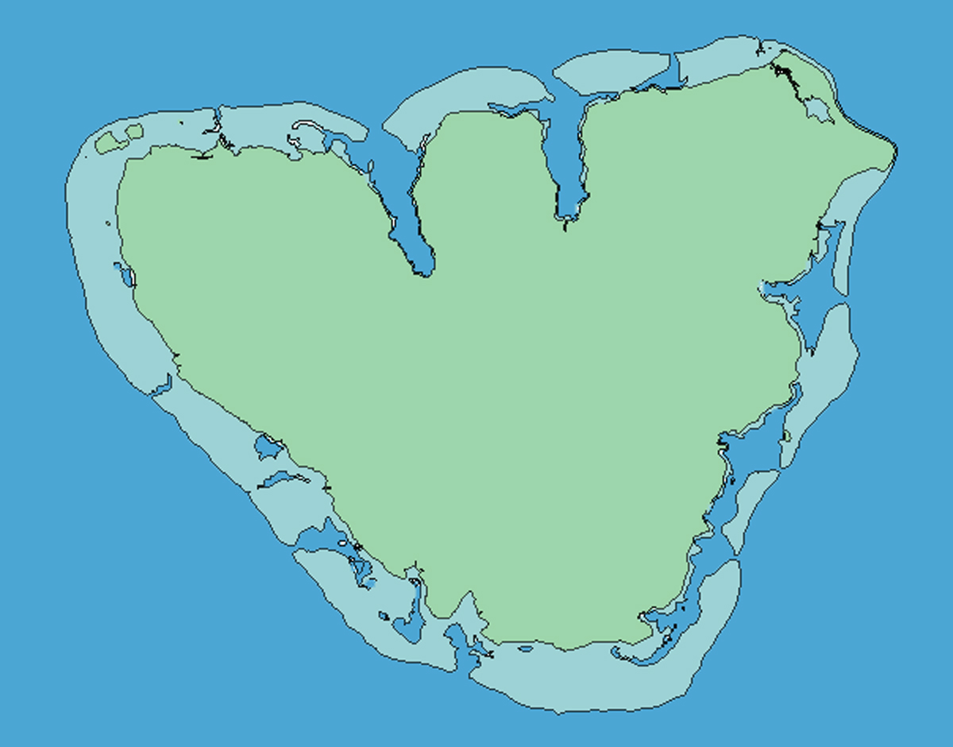
MCR Sensor Deployments (non-real-time)
N
MCR LTER 2
MCR LTER 1
MCR LTER 6
Cook’s Bay
MCR LTER 3
MCR LTER 4
MCR LTER 5
Moorea
French Polynesia
Rev. 10 June 2009
Approach: Incrementally bring deployments into real-time system

Slide 7
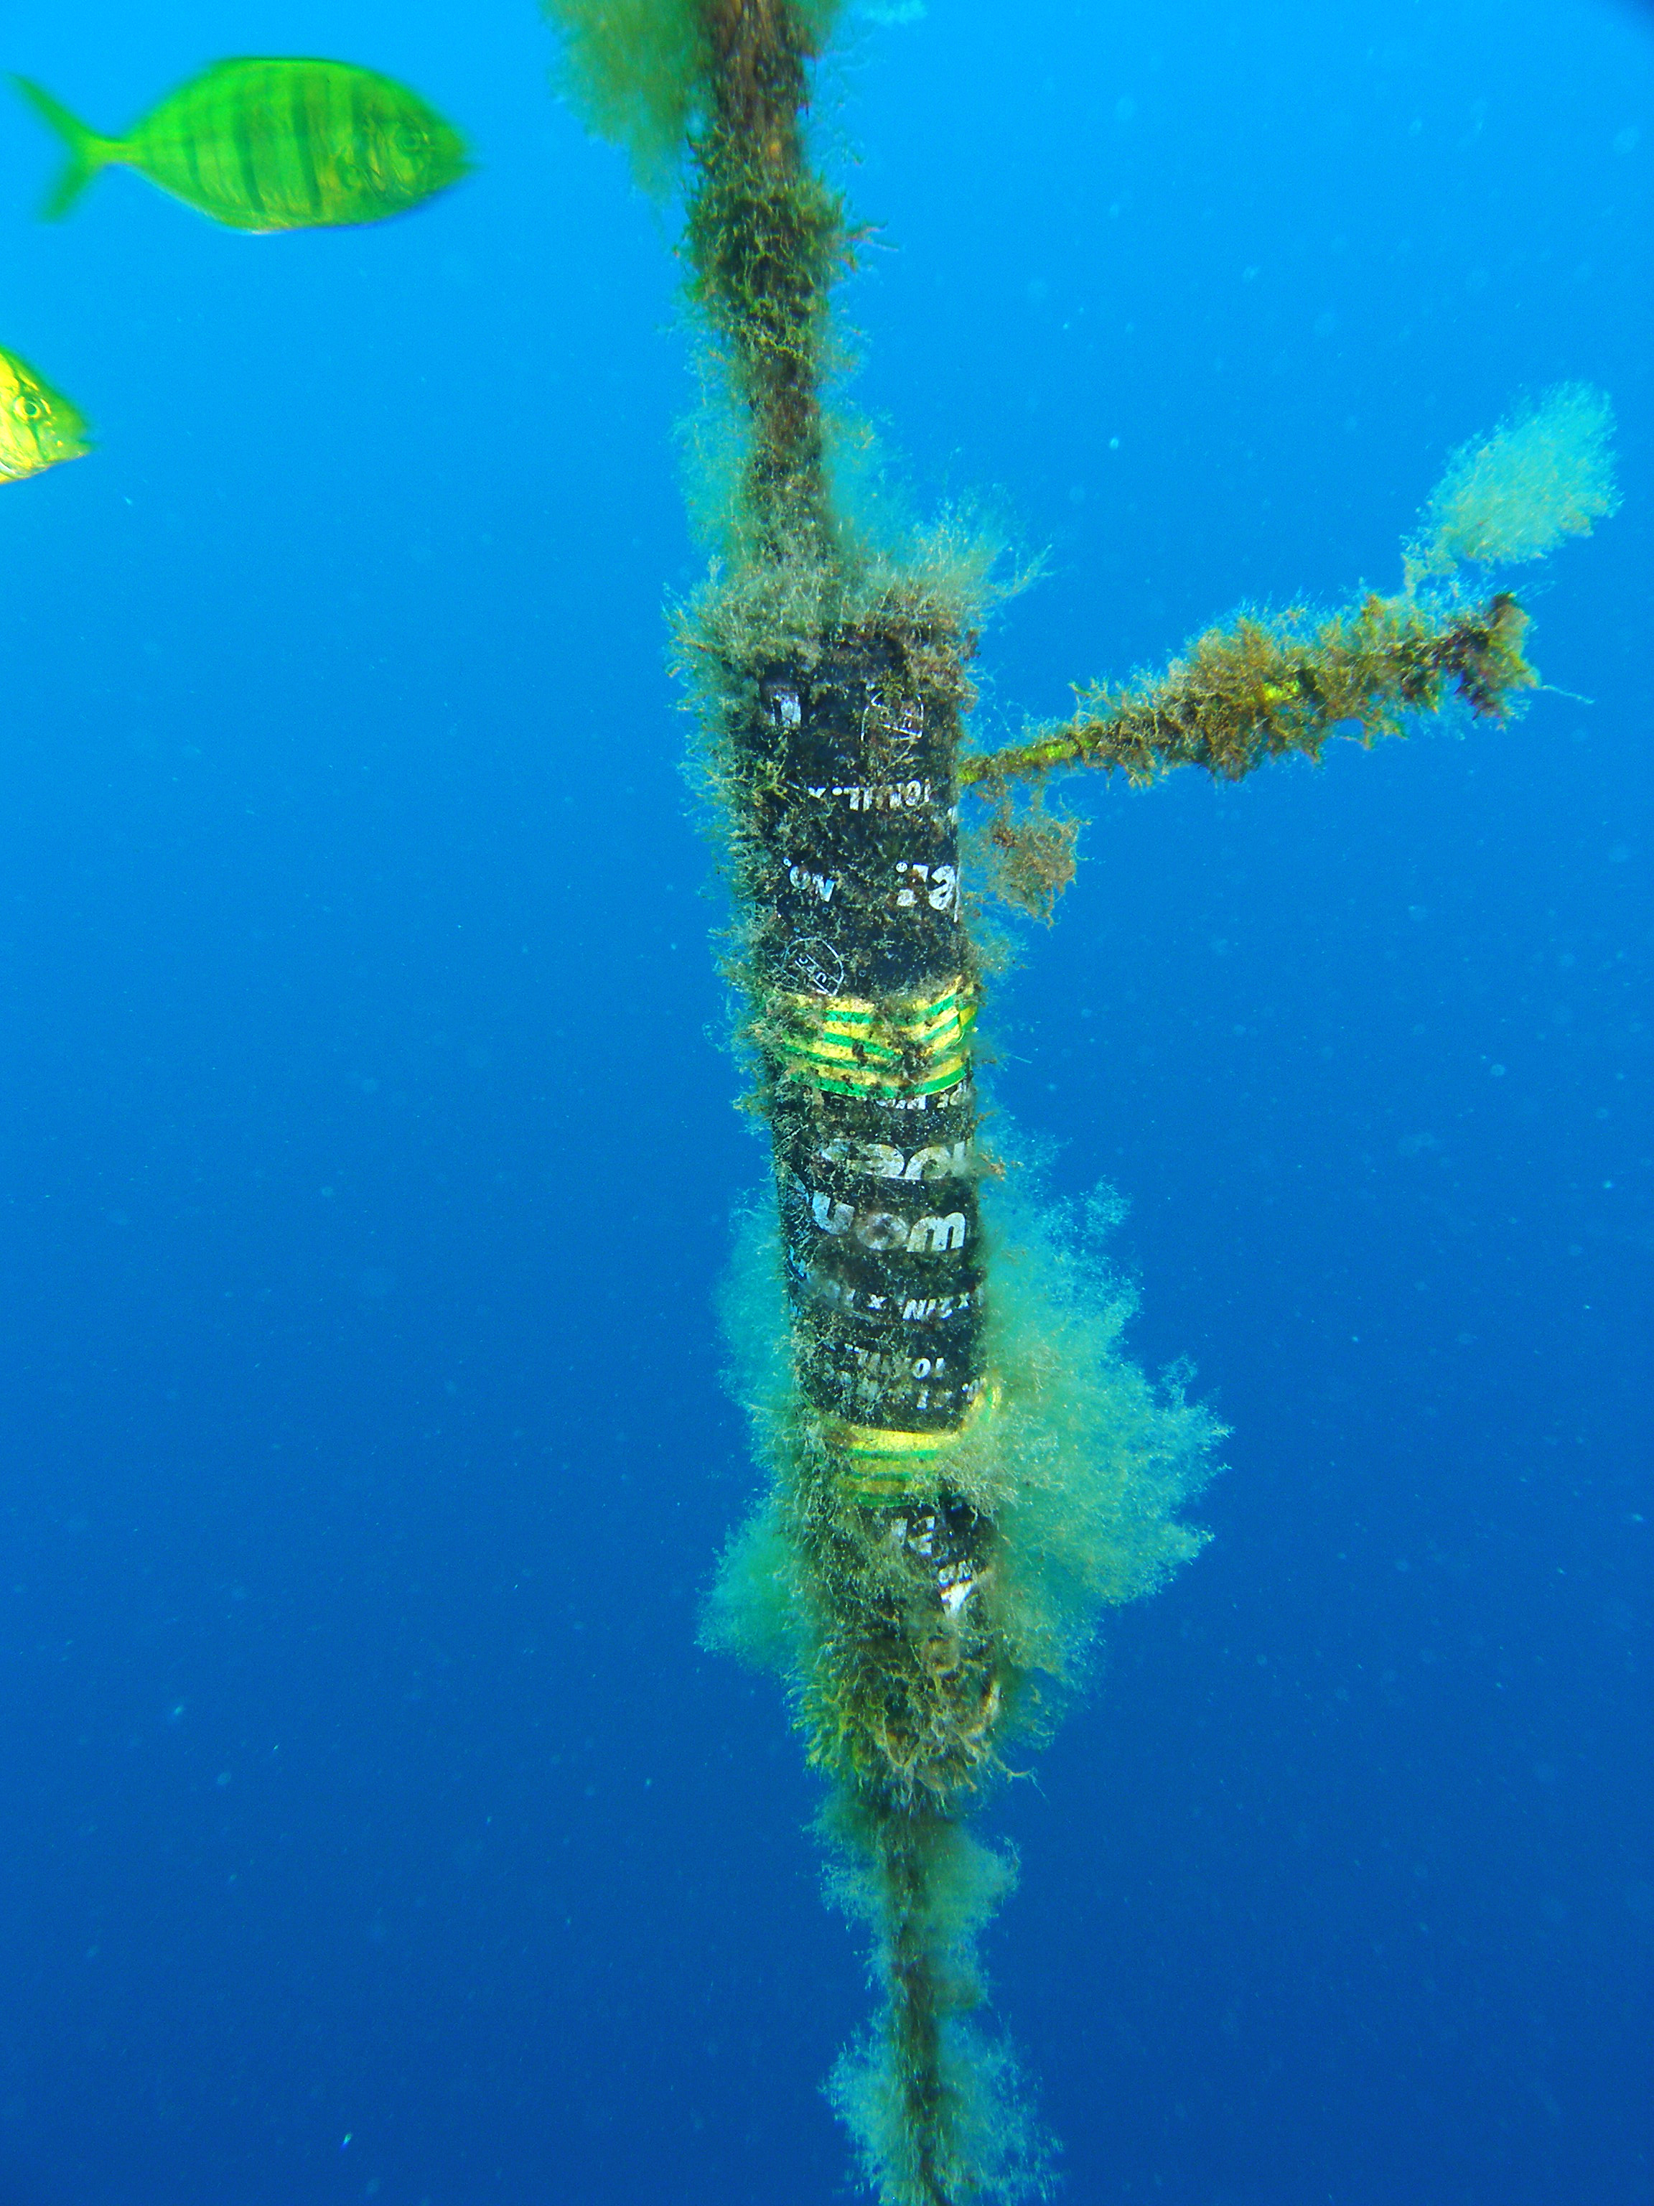
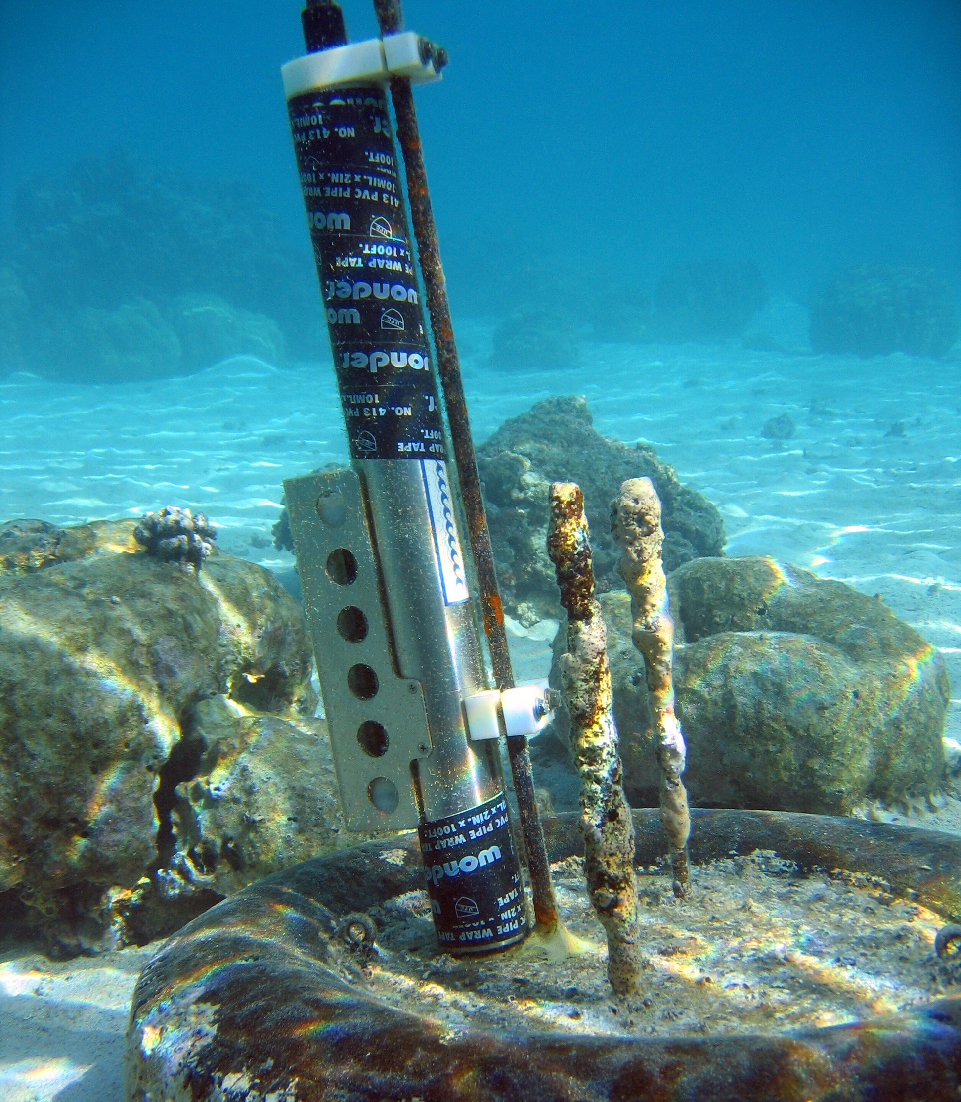
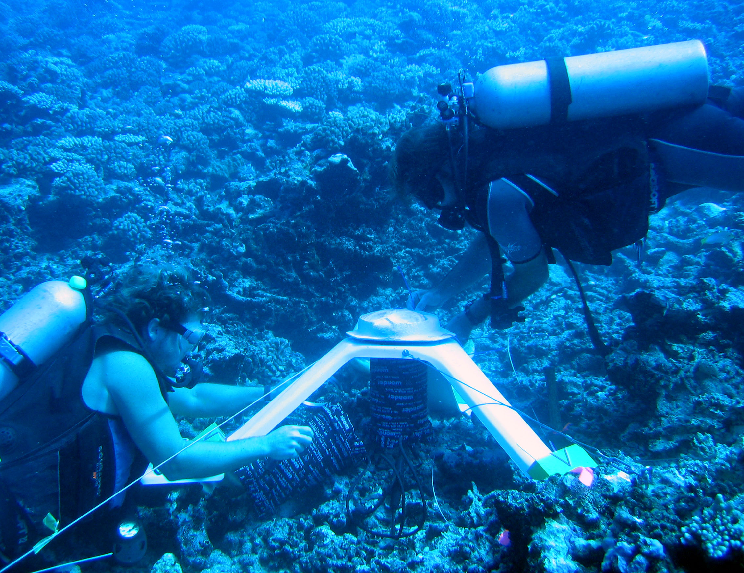
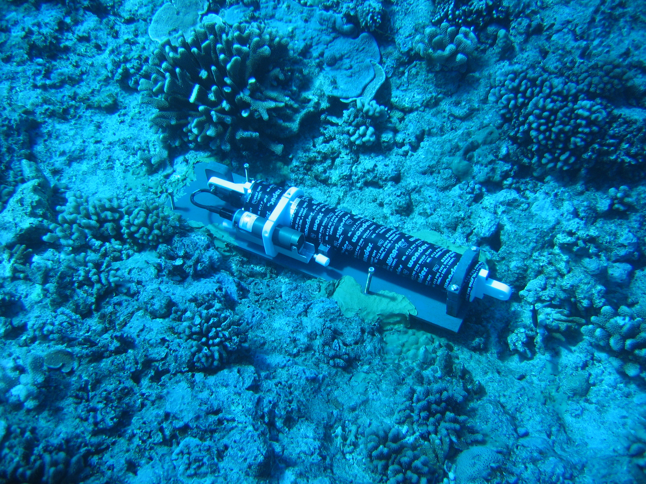
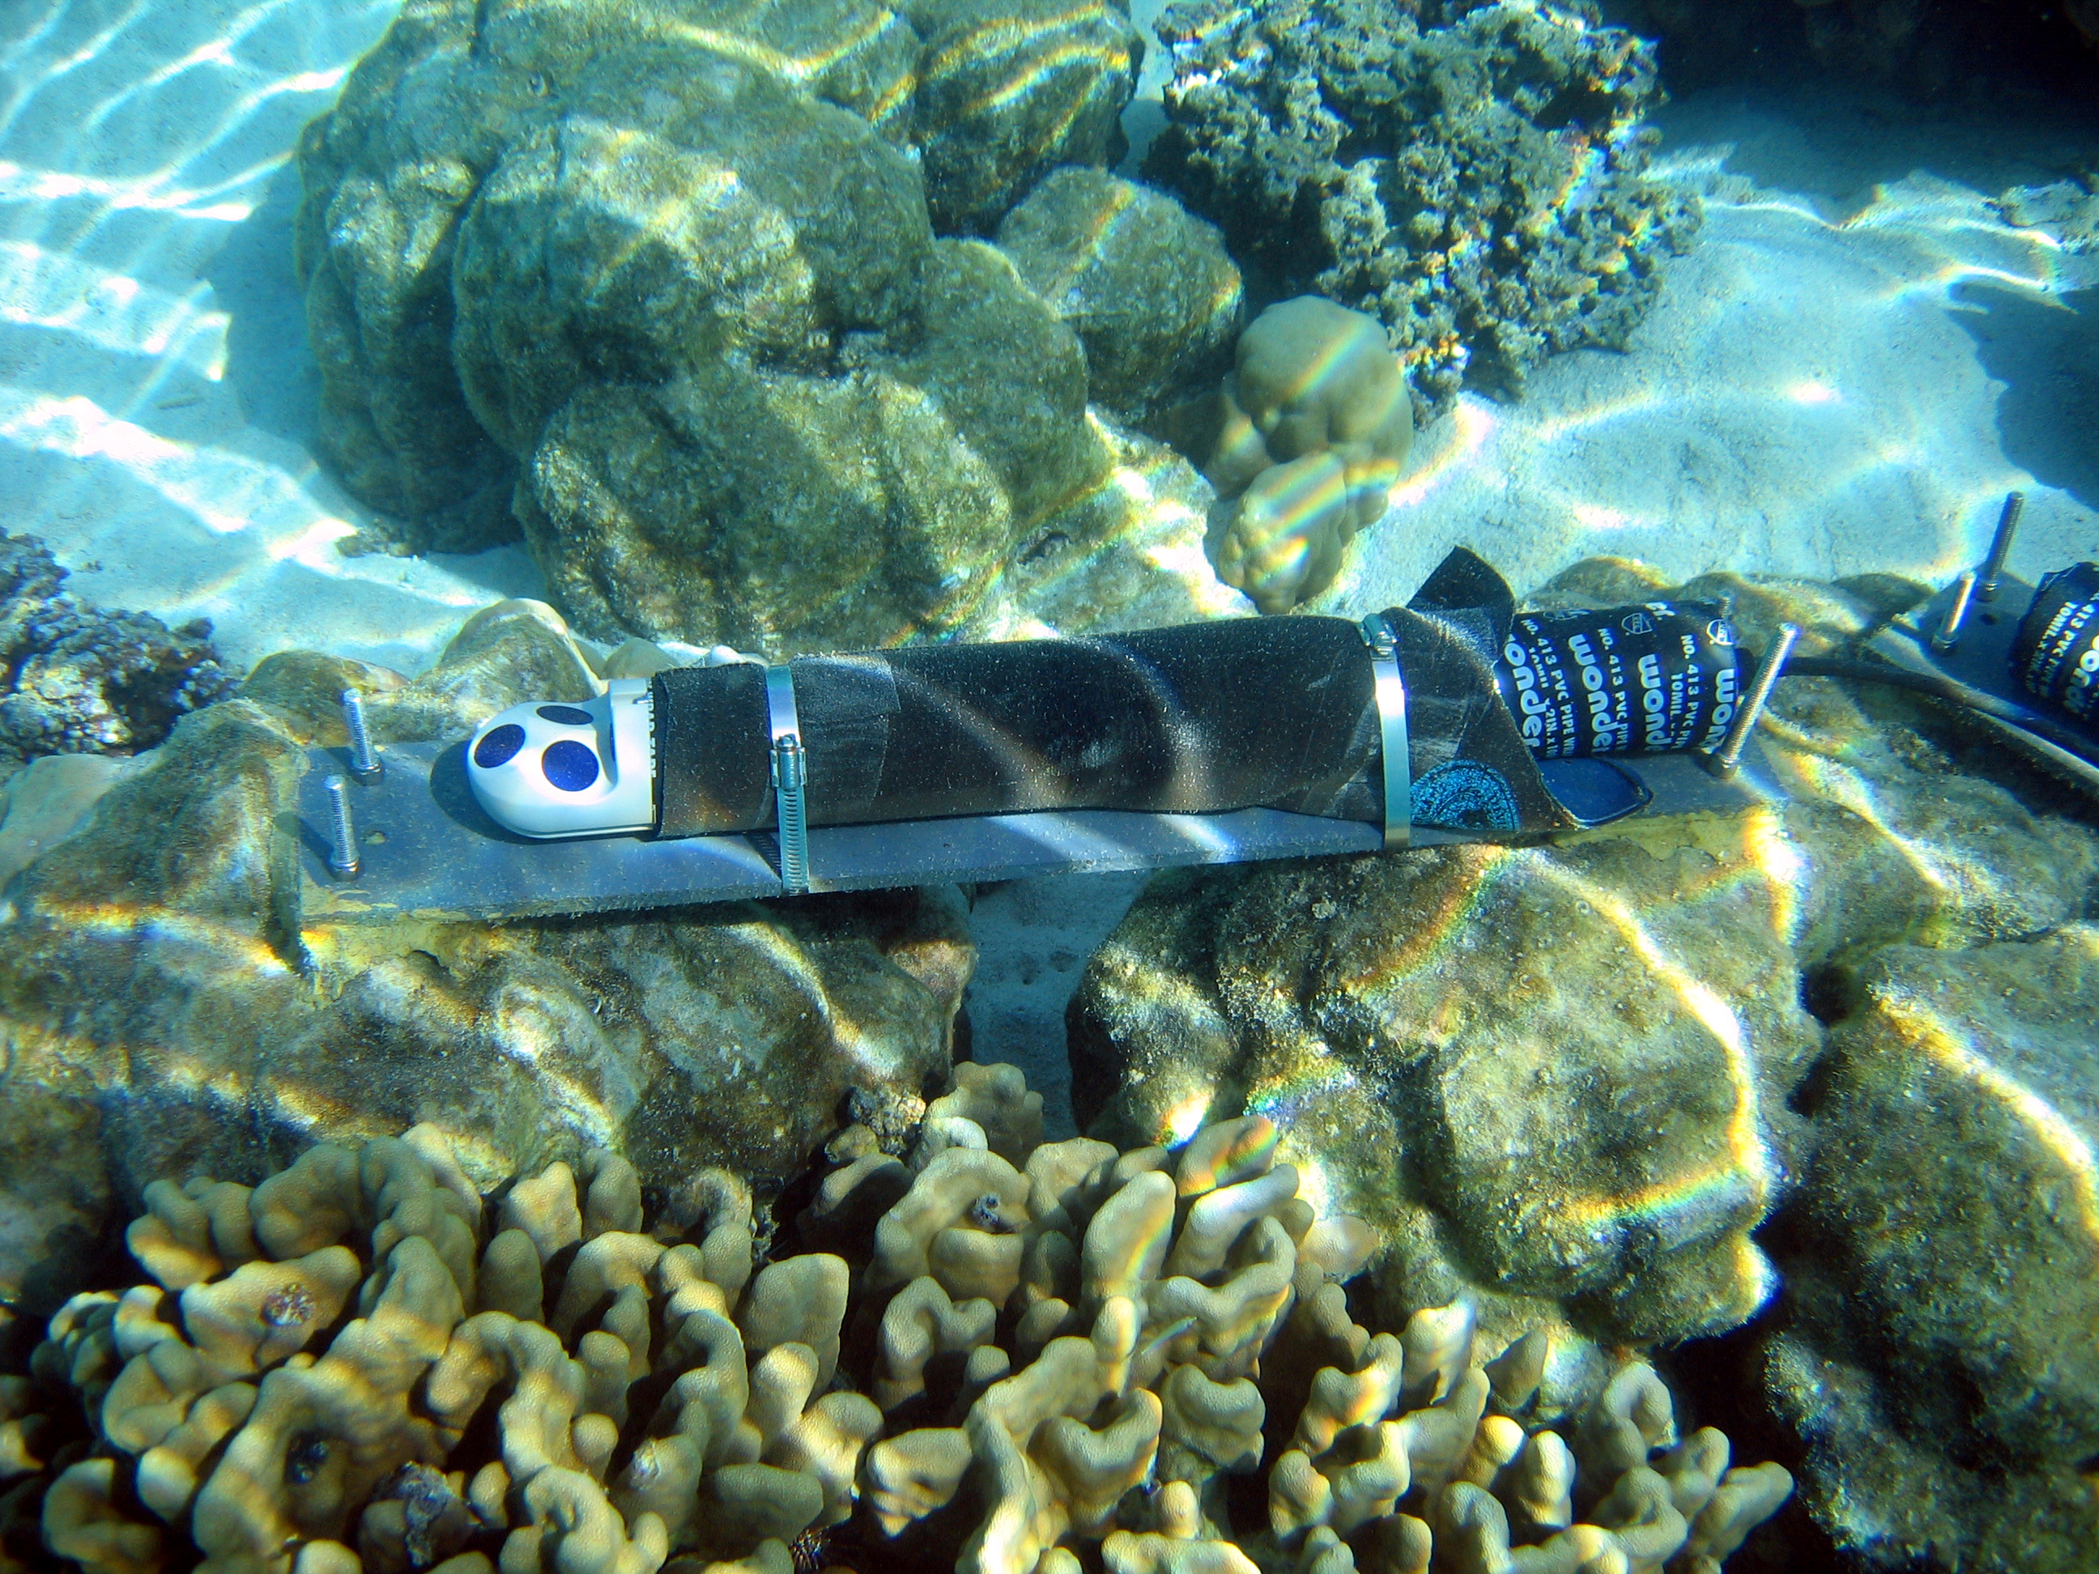
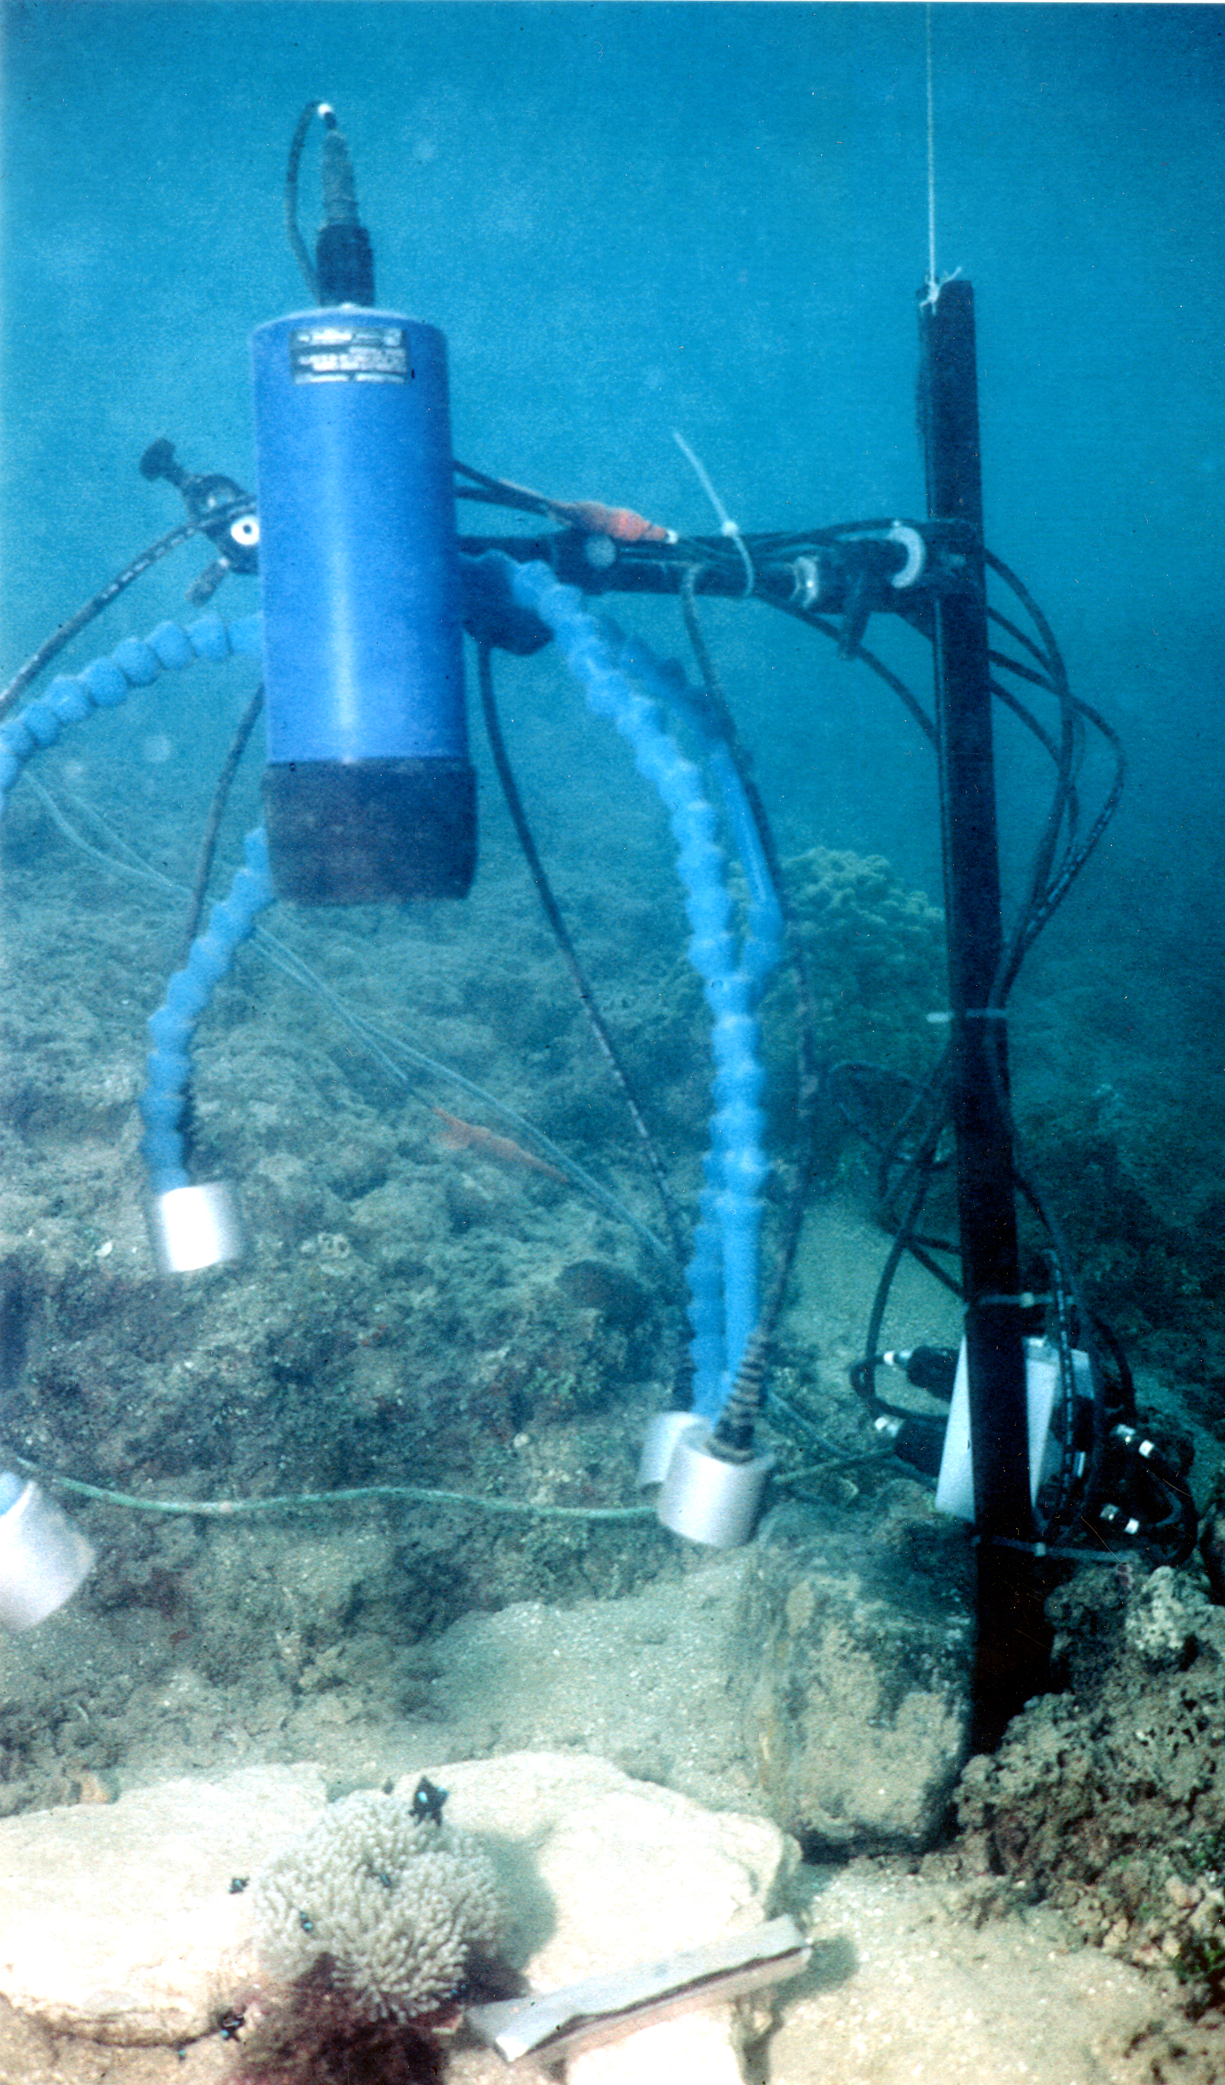
MCR Sensors
ADCP
Thermistor
CTD
Wave - Tide Pressure Sensor
ADP
Infrared video

Slide 8
System Requirements
Heterogeneous sensors/instruments: The system must support integration of numerous instruments from a variety of vendors.
Real-time processing: The system must support acquisition and processing of observations in real-time.
Automated event detection: The system must be able to detect and respond to events in near real time.
Data acquisition over wired and wireless networks: The system must operate efficiently over a variety of network infrastructures.
Support for evolving research programs: The CI must be extensible and easily configurable.
Interoperability with other coral reef observatories.

Slide 9
Risks and Challenges
Remote location and long distance data acquisition are challenges. Moorea is approximately 6,600 km from the Data Center at UCSD.
The remote management of software services and hardware components is difficult. This is further complicated by a lack of dedicated IT staff on the island.
Unreliable power sources on Moorea are the norm. The island power infrastructure is subject to frequent blackouts, brownouts, and power surges
Hardware equipment failures have been common. Digital Moorea consists of numerous infrastructure components, all of which are subject to failure.
Limited and evolving global-scale networking infrastructure presents challenges for application tuning and operations.

Slide 10
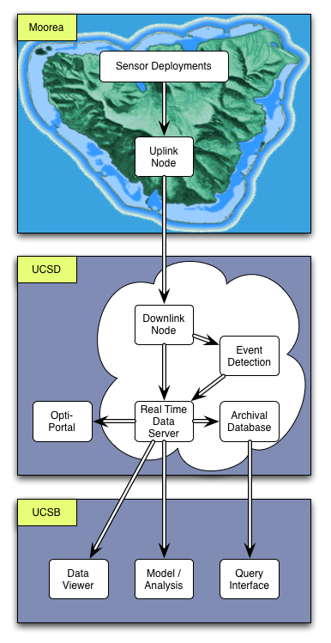
Digital Moorea
Current System
Island infrastructure
Sensors, data acquisition devices, routers, etc.
UCSD Data Center
Servers for data management, event processing, databases, etc.
Client applications
Data viewers, analysis packages, database queries

Slide 11
Current Instrumentation
Plus dataloggers, routers, serial to Ethernet boxes.

Slide 12
UCSD Data Center
Manage real-time data streams and applications
Partition acquisition, processing, and publishing
Modularity, scalability, robustness
Employ cloud-computing concepts
Services (Application As A Service, AAAS)
Open Geospatial Consortium (OGC) Sensor Web Enablement (SWE) services
(www.opengeospatial.org/projects/groups/sensorweb).
Virtualization (abstraction over computer hardware)
Utilize the Xen hypervisor (xen.org/, www.redhat.com).
Utility computing (pay-as-you-go-model)
Plan to migrate virtual machines to other cloud-computing platforms including Amazon’s E2C (aws.amazon.com/ec2/).

Slide 13
Benefits of Virtualization
Portability across hardware platforms.
Simplified system administration (less physical machines to manage).
Increased uptime and faster failure recovery (since virtual machines are not bound to any physical machine, they are more portable and can be efficiently migrated across physical machines).
Elasticity: the ability to acquire and release compute resources as demand waxes and wanes.

Slide 14
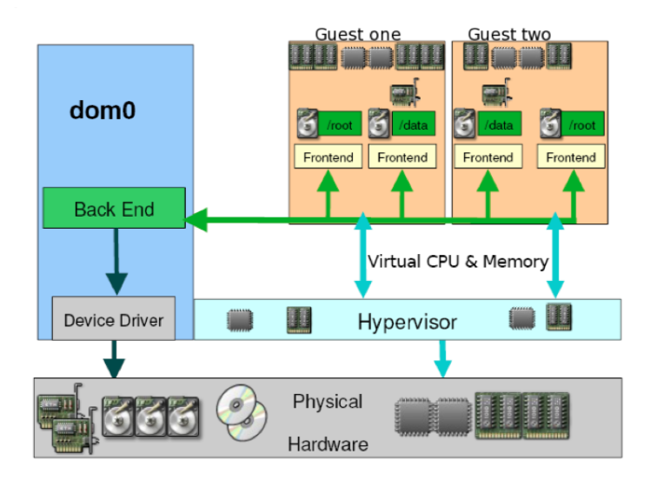
Xen Hypervisor
Sits above the hardware
Controls execution of virtual machines.
Responsible for CPU scheduling and memory partitioning of virtual machines.
In the current Digital Moorea deployment we utilize the Xen hypervisor.
The host OS is Red Hat Enterprise Linux (RHEL) and guest operating systems are also RHEL.

Slide 15
Real-time Event Processing
State of health monitoring of system
Detect problems early to avoid data loss, minimize system down time
Examples: sensor, network, server failures, QoS breaches.
Environmental phenomena
Detect events of interest in science data and respond (e.g., adaptive sampling, initiate campaign-style deployments).
Examples: Onset of coral bleaching, nutrient runoff, internal waves, tsunami warning.

Slide 16
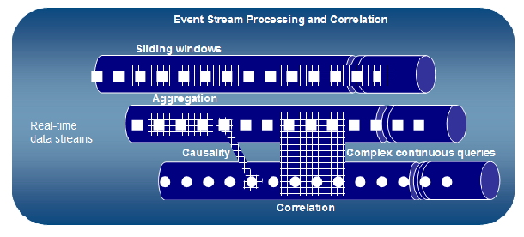
Event Stream Processing with ESPER
ESPER: Open source event stream processing (ESP) and event correlation engine (CEP). (http://www.espertech.com/products/esper.php)
Detect situations in real-time and to trigger custom actions when event conditions occur among event streams.
Provides a rich Event Processing Language (EPL) to express filtering, aggregation, and joins, over sliding windows of multiple event streams.
Provides pattern semantics to express complex temporal causality among events.

Slide 17
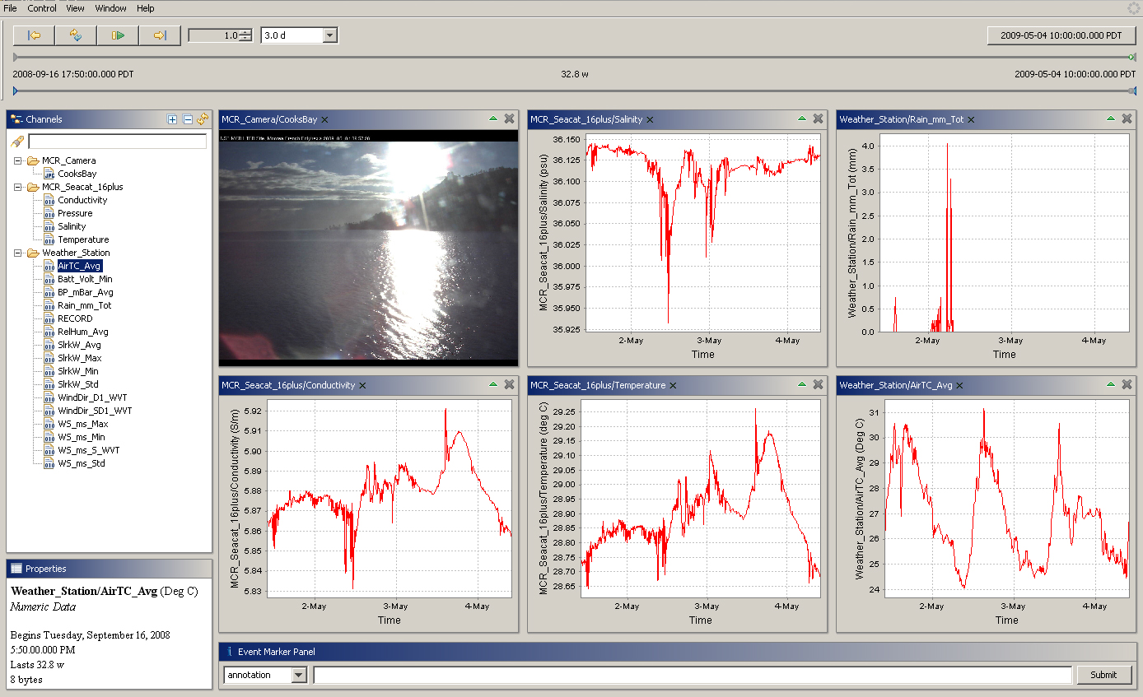
Digital Moorea Data Streams

Slide 18
Next Deployment Hardware
Buoy
Buoy
The buoy contains antenna, wifi-modem, data logger, battery, and inductive modem.
CTP sensor
Five SBE 37s will measure conductivity, temperature and pressure at different depth.
TP sensor
Three SBE 39s will measure the temperature and pressure.
ADCP
Wave & Tidal Recorder
water
5 CTP
3 TP
ADCP
Wave & Tidal Recorder
Sea Floor

Slide 19
Summary
Status
Current System deployed and stable since April 2009
Passed numerous tests for reliability and performance
Future Plans
Next deployment buoy and sensors
OGC SWE services integration
Portability and elasticity experiments on multiple compute clouds
Integration with other sites in the Coral Reef Environmental Observatory Network
Paper can be downloaded at: http://www.dataturbine.org/publications/digital-moorea-cyberinfrastructure-coral-reef-monitoring

Slide 20
Acknowledgements
Open Source DataTurbine Team
Open Source DataTurbine Partners
Funding Agencies
National Science Foundation
Gordon and Betty Moore Foundation
Corporate Partners
Erigo Technologies
Creare Inc.

